Slide 1
coffee house app
sreeja

Slide 2
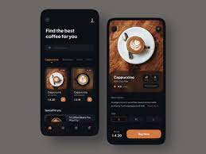
Project overview
The product:
Its an app and website for coffee house
you can coffee and snacks from home ,other location
Preview of selected polished designs.
Project duration:
This app has been completed with in a month

Slide 3
Project overview
The problem:
the coffee shop sit out is too tiny and have to wait in a long line to get a coffee .one person ly available in billing couter
The goal:
The goal of the project was to create a app for who lead a busy life and who cannat come to shop directly

Slide 4
Project overview
My role:
I work as a UX designer
Responsibilities:
I am responsible for prototyping,ux research,IA,visual design,wire framing,effective communication

Slide 5
User research
Personas
Problem statements
User journey maps
Understanding
the user

Slide 6
User research: summary
I conducted interview directly and get the ratings from online surveys for this app. create an empathy maps to know the feeling of users about this
i interviewed coffee house employees and users. i hope they are satisfied with this app

Slide 7
User research: pain points
1
2
3
4
TIME
ACCESSABILITY
service
ONLINE APP
SOMETIMES WORKING
ADULTS CANNOT
SPEND TIME TO MAKE A MEAL
platform is not sopportted
with accessability to order the food
customer service is not good sometimes i cant track the order
i cannot make the order
when it is on offline it needs internet connection

Slide 8

Persona
live and let live others
Frustrations
frustration is the coordination of their pick-up. Sometimes a large order is incomplete or incorrect. Other times the order sits too long and their coffee or hot food items get cold.
Goals
try to get my orders fast,
i should deliver the coffee to
every person who has ordered
jennifer
name:
Age:
Education:
Hometown:
Family:
Occupation:
jennifer
22
jersey city
2 sister
junior business developer
jennifer is a mba degree holder.she works in mnc company which is lacated on newyork.

Slide 9
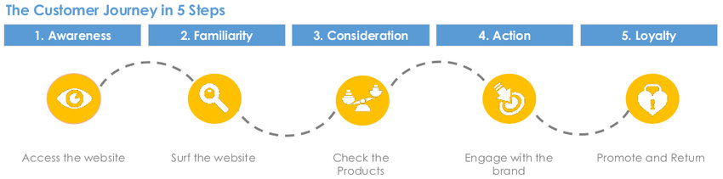
User journey map
[my goal is to empathize the user and create an app to user for great experience
Image of user journey map

Slide 10
Persona: jennifer
ACTION | collect orders | go to coffee house | place the order | wait for order | pick up the order
TASK LIST | Tasks collect orders from workers collect money for orders | Tasks go to coffee house check the menu wait in line | Tasks place the order check the order checkout the order | Tasks get the paper tissue ,suger,mixing stick | Tasks pick up the order check the orders
FEELING ADJECTIVE | happy to connect the workers worried about make order errors | nervous about go back to work in time | User emotions should not miss the order by entering the order | User emotions stressed by waiting for order | User emotions hopefully every order should be given correctly
IMPROVEMENT OPPORTUNITIES | collect orders in door step or your current location | create an app for easy access | collect multiple orders from your location | an app must have status update | order should have delivery option and pick up option

Slide 11
Paper wireframes
Digital wireframes
Low-fidelity prototype
Usability studies
Starting
the design

Slide 12
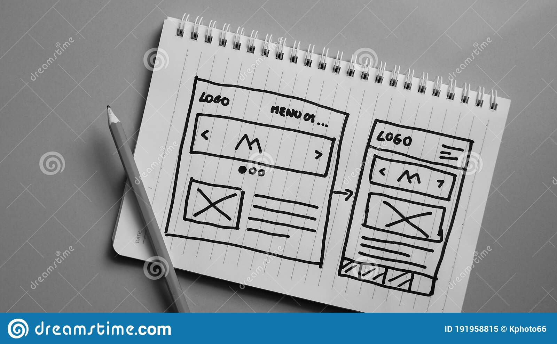
Paper wireframes
drew the paper wireframes through note and sketch
Image of paper wireframes including five different versions of the same screen and one image of the new, refined version

Slide 13
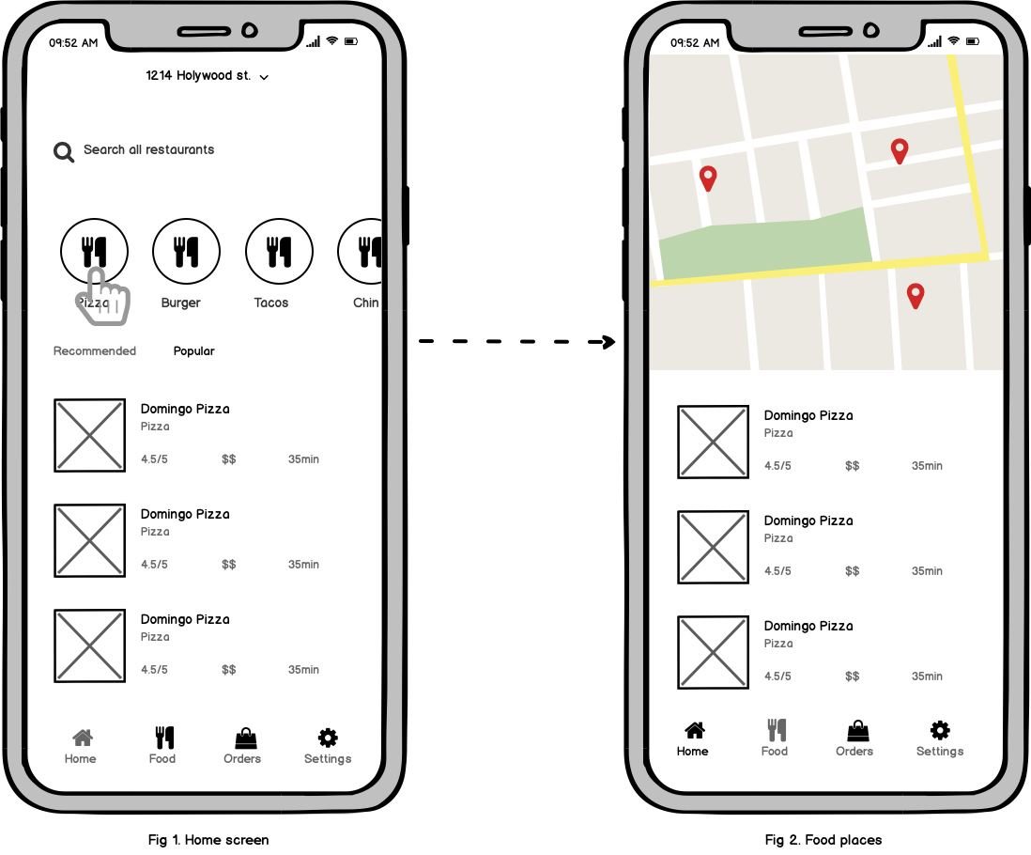
Digital wireframes
you can order
food by listed items
to create the wireframes directly in the system
Insert first wireframe example that demonstrates design thinking aligned with user research
track the parcel throuh this app

Slide 14
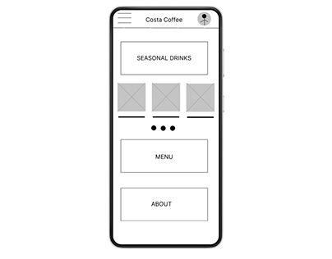
Low-fidelity prototype
low fidelity prototype is aquick and easy way to translate the design

Slide 15
Usability study: findings
Write a short introduction to the usability studies you conducted and your findings.
Round 1 findings
Round 2 findings
1
useful
1
desirable
findable
usable
2
2
3
Accessible
3
communication

Slide 16
Refining
the design
Mockups
High-fidelity prototype
Accessibility

Slide 17
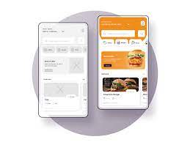
Mockups
Before usability study
After usability study
A mockup is a visual way of representing a product. While a wireframe mostly represents a product's structure, a mockup shows how the product is going to look like
Image of selected screen before usability study
Image of selected screen after usability study

Slide 18
Mockups
Main mockup screen for dy
Main mockup screen for display

Slide 19
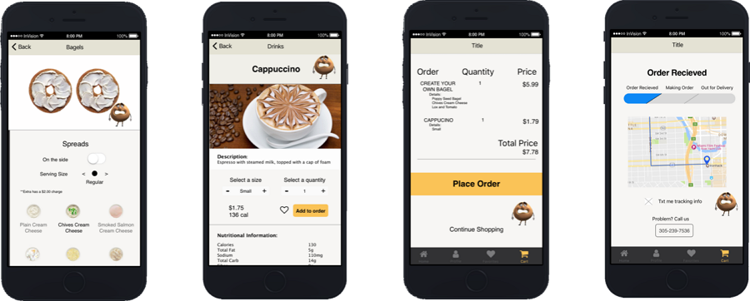
High-fidelity prototype
[High-fidelity prototypes are computer-based, and usually allow realistic (mouse-keyboard) user interactions. .

Slide 20
Accessibility considerations
1
2
3
Optimize Your App's Color Contrasts.
Optimize All Video and Audio Content.
Design for Varying Screen Sizes. ...
Focus on Touch Targets and Placement. ...
Use Labels

Slide 21
Going forward
Takeaways
Next steps

Slide 22
Takeaways
Put More Focus on Interaction. Online experience is getting more granular, interfaces get more detailed, details get more functional. ...
The deliverables for a project are the tangible record of the work that occurred, whether that work was research or design. Some of the classic deliverables that come out of UX work are usability-test reports, wireframes and prototypes, site maps, personas, and flowcharts.

Slide 23
Next steps
1
2
Look into the webpages and recognize if the user experience satisfies me.
Look into the user reviews and validate if the user experience needs rebranding.

Slide 24
Insert a few sentences summarizing the next steps you would take with this project and why. Feel free to organize next steps in a bullet point list.
Let’s connect!
sreeja
mail id: sreeja1494@gmail.com

Slide 25
Thank you!

Slide 26
live and let live others
Goals
try to get my orders fast,
i should deliver the cofee to
every person who has ordered
Frustrations
frustration is the coordination of their pick-up. Sometimes a large order is incomplete or incorrect. Other times the order sits too long and their coffee or hot food items get cold.
Name
Age:
Education:
Hometown:
Family:
Occupation:
jennifer
22
jersey city
2 sister
junior business developer
jennifer is a mba degree holder.she works in mnc company which is lacated on newyork.

Slide 27
[coffee house user]
customer
pick up an order quickly
i can drink my coffee without getting cold

